Slide 1
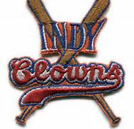
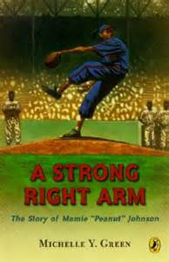
A Strong Right Arm
Michelle Y. Green
Evin Stanford & Jett Swift

Slide 2
Author
Green is a graduate of the university of Maryland college of journalism. She writes kids books

Slide 3
I n the story we found vocabulary words.
Word: cocked sentence: “Trying to throw a ball with your arm cocked.” Def.: tilted
Word: precinct sentence: ...“planting me facing a precinct wall.” Def.: police station
Word: manicure Sentence: …“from manicured lawns with chalk lines as sweet as baby powder.” Def.: well-cared for.
Word: molasses Sentence: …” the speed of a snail in molasses.” Def.: a sweet, sticky ingredient.
Word: desegregated sentence: …”it was the same year that the president desegregated the armed forces.” Def.: stop seperating.

Slide 4
SUMMARY
In the story there is a girl and her name is Mamie “Peanut” Johnson. She wanted to play Professional baseball but all the teams were white-men teams, so there was no room for a colored women. During the story a lot of things got in her way. Even though things got in her way she never gave up.

Slide 5
JETT’S FAVORITE CHARACTER: BONES
I like Bones because he taught Mamie how to play baseball. He pitches like a pro! Maybe that is where Mamie got her talent. He is also is caring, loving, cheerful,& kind. He was sad because Mamie moved away.

Slide 6
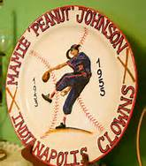
Evin’s Favorite Character: Mamie
My favorite character is Mamie. She likes baseball, she never gave up, she believed that she could become a professional ball player, and she inspired by the legendary Jackie Robinson.
During the story Mamie was kind, smart, and sportive. She was sad because her grandma died. She was happy because she made Indianapolis Clowns

Slide 7
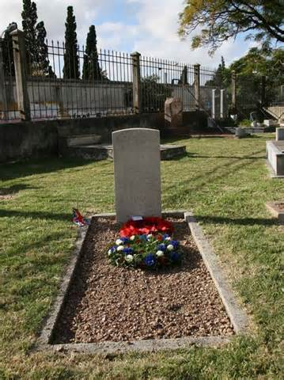
Mamie used to live with her grandma till her grandma died. After her grandma died she had to live with her aunt.

Slide 8
When Mamie was at her aunts house she tried out for the PAL but she moved to her mom’s house in Washington D.C.

Slide 9
We liked the book because Mamie never gave up so that inspired me to never give up. We also liked the book because Mamie was a girl playing baseball and she was a pitcher and it was pretty cool.

Slide 10
We think you should read this book because we think it will inspire you to never give up. You will see the happy & sad parts while Mamie was becoming a professional baseball player.

Slide 11
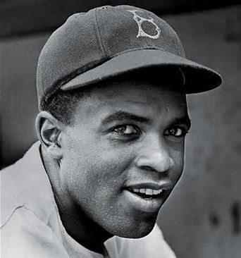
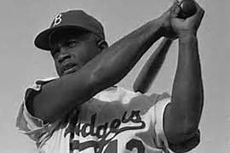
Mamie was playing baseball and someone saw her and wanted her to try out for the Indianapolis Clowns. She admired Jackie Robinson.

Slide 12
Mamie made the Indianapolis Clowns. During a game when Mamie was pitching someone called her Peanut and that became her nickname.

Slide 13
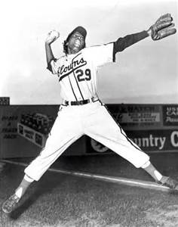
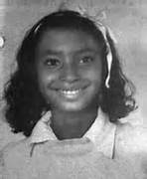
Mamie is very small she is 5.2. that is why her nickname is Peanut. Her friend was Toni Stone

